Slide 1
DESIGN ENGINEERING

Slide 2
Design model
Components of a design model :
Data Design
Transforms information domain model into data structures required to implement software
Architectural Design
Defines relationship among the major structural elements of a software
Interface Design
Describes how the software communicates with systems that interact with it and with humans.
Component level Design
Transforms structural elements of the architecture into a procedural description of software components

Slide 3
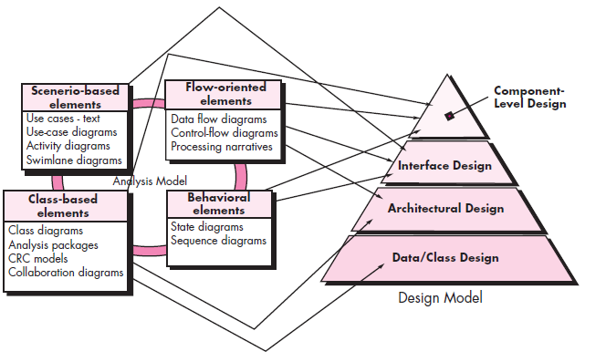

Slide 4
Software Design -- An iterative process transforming requirements into a “blueprint” for constructing the software.
Goals of the design process:
The design must implement all of the explicit requirements contained in the analysis model and it must accommodate all of the implicit requirements desired by the customer.
The design must be a readable, understandable guide for those who generate code and for those who test and subsequently support the software.
The design should address the data, functional and behavioral domains from an implementation perspective

Slide 5
Quality Guidelines
1. A design should exhibit an architecture that
has been created using recognizable architectural styles or patterns,
(2) is composed of components that exhibit good design characteristics
(3) can be implemented in an evolutionary fashion, thereby facilitating implementation and testing.
2. A design should be modular; that is, the software should be logically partitioned into elements or subsystems

Slide 6
3. A design should contain distinct representations of data, architecture, interfaces, and components.
4. A design should lead to data structures that are appropriate for the classes to be implemented and are drawn from recognizable data patterns.
5. A design should lead to components that exhibit independent functional characteristics.
6. A design should lead to interfaces that reduce the complexity of connections between components and with the external environment.
7. A design should be derived using a repeatable method that is driven by information obtained during software requirements analysis.
8. A design should be represented using a notation that effectively communicates its meaning

Slide 7
Quality attributes
Functionality – ability of the system to do the work for which it was intended
Usability – ease of use ( user friendliness)
Reliability – failure free software operation
Performance - responsiveness
Supportability – identifying and resolving issue when software fails

Slide 8
Design Attribute for a Good Software
Cohesion
Coupling
Layering
Abstraction
Fan-in - Is the number of modules that call a given module.
Fan-out - Is the numbers of modules that called by a given module.
Scope of re-use
Error of isolation
Clear Decomposition
Modularity - refers to the extent to which a software may be divided into smaller modules
Correctness, maintainability, understandability and efficiency

Slide 9
Design Concepts
Abstraction
At the highest level of abstraction a solution is stated in broad terms
At lower levels of abstraction, a more detailed description of the solution is provided.

Slide 10
Design Concepts(Abstraction)
Types of abstraction :
1. Procedural Abstraction :
A named sequence of instructions that has a specific &
limited function
Eg: Word OPEN for a door
2. Data Abstraction :
A named collection of data that describes a data object.
Data abstraction for door would be a set of attributes
that describes the door
(e.g. door type, swing direction, weight, dimension)

Slide 11
Design Concepts
Software architecture refers to “the overall structure of the software and the ways in which that structure provides conceptual integrity for a system”
A set of properties should be specified as part of an architectural design:
Structural properties. This aspect of the architectural design representation defines the components of a system (e.g., modules, objects) and the manner in which those components are packaged and interact with one another.
Extra-functional properties. The architectural design description should address how the design architecture achieves requirements for performance, reliability, security, adaptability, and other system characteristics.
Families of related systems. The design should have the ability to reuse architectural building blocks.

Slide 12

Design Concepts
Modularity
In this concept, software is divided into separately named and addressable components called modules
Follows “divide and conquer” concept, a complex problem is broken down into several manageable pieces

Slide 13
Design Concepts(Modularity)
Five criteria to evaluate a design method with respect to its modularity :
Modular understandability
module should be understandable as a standalone unit (no need to refer to other modules)
Modular continuity
If small changes to the system requirements result in
changes to individual modules, rather than system wide
changes, the impact of side effects will be minimized
Modular protection
If an error occurs within a module then those errors are localized and not spread to other modules.

Slide 14
Design Concepts(Modularity)
Modular Composability
Design method should enable reuse of existing
components.
Modular Decomposability
Complexity of the overall problem can be reduced if the design method provides a systematic mechanism to decompose a problem into sub problems

Slide 15
Design Concepts
Information Hiding
Information (data and procedure) contained within a module should be inaccessible to other modules that have no need for such information.
Hiding defines and enforces access constraints to both procedural detail within a module and any local data structure used by the module.

Slide 16
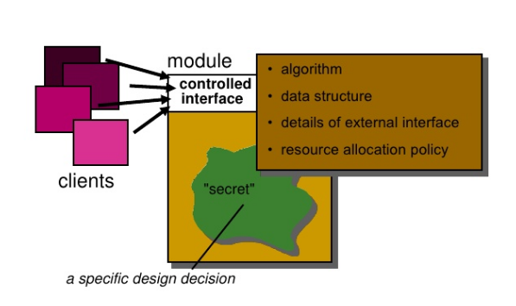
Information hiding

Slide 17
Design Concepts
Functional Independence
Functional independence is achieved by developing modules with “single minded” function and an aversion to excessive interaction with other modules.
Measured using 2 qualitative criteria:
Cohesion : Measure of the relative strength of a module.
Coupling : Measure of the relative interdependence among modules.

Slide 18
Cohesion
Definition
The degree to which all elements of a component are directed towards a single task.
The degree to which all elements directed towards a task are contained in a single component.
The degree to which all responsibilities of a single class are related.
All elements of component are directed toward and essential for performing the same task.

Slide 19
Cohesion
Different types of cohesion :
Functional Cohesion (Highest):
A functionally cohesive module contains elements that all contribute to the execution of one and only one problem-related task.
Examples of functionally cohesive modules are
Compute cosine of an angle
Calculate net employee salary

Slide 20
Cohesion
2. Sequential Cohesion :
A sequentially cohesive module is one whose elements are involved in activities such that output data from one activity serves as input data to the next.
Eg: Module read and validate customer record
Read record
Validate customer record
Here output of one activity is input to the second

Slide 21
Cohesion
3. Communicational cohesion
A communicationally cohesive module is one whose elements contribute to activities that use the same input or output data.
Suppose we wish to find out some facts about a book
For instance, we may wish to
FIND TITLE OF BOOK
FIND PRICE OF BOOK
FIND PUBLISHER OF BOOK
FIND AUTHOR OF BOOK
These four activities are related because they all work on the same input data, the book, which makes the “module” communicationally cohesive.

Slide 22
Cohesion
Eg: module which produces employee salary report and calculates average salary
Produce employee salary report
Employee salary report details
Employee salary table
Calculate average salary
Average salary

Slide 23
Cohesion
4. Procedural Cohesion
A procedurally cohesive module is one whose elements are involved in different and possibly unrelated activities in which control flows from each activity to the next.
Eg:
addRecord
changeRecord
deleteRecord

Slide 24
Cohesion
5. Temporal Cohesion
A temporally cohesive module is one whose elements are involved in activities that are related in time.
Eg:
An exception handler that
Closes all open files
Creates an error log
Notifies user

Slide 25
Cohesion
6. Logical Cohesion
A logically cohesive module is one whose elements contribute
to activities of the same general category in which the activity
or activities to be executed are selected from outside the
module.
A logically cohesive module contains a number of activities of the same general kind.
To use the module, we pick out just the piece(s) we need.
Eg:
Read from file
Read from database

Slide 26
Cohesion
7. Coincidental Cohesion (Lowest)
A coincidentally cohesive module is one whose elements contribute to activities with no meaningful relationship to one another.
Eg. When a large program is modularized by arbitrarily segmenting the program into several small modules.

Slide 27
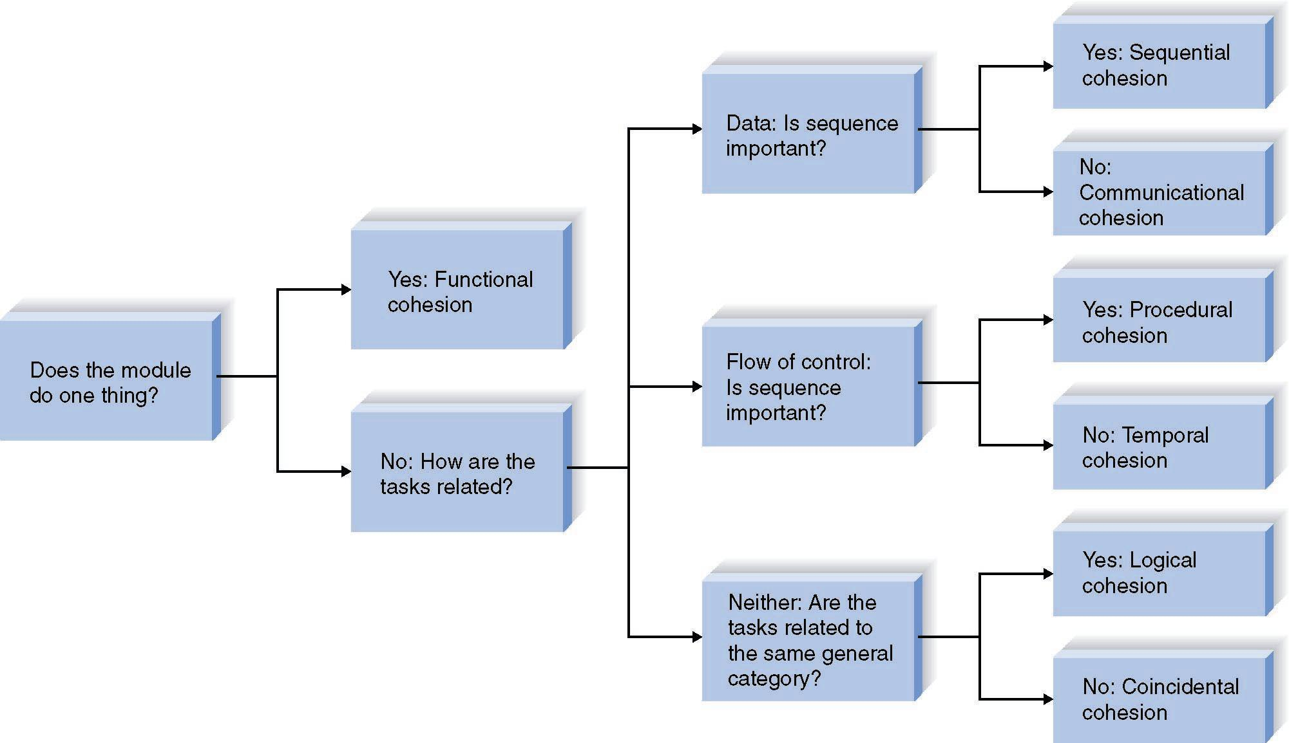
Cohesion
A decision tree to show module cohesion

Slide 28
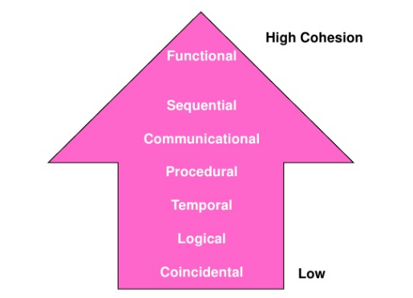

Slide 29
Coupling
Measure of interconnection among modules in a software structure
Strive for lowest coupling possible.

Slide 30
Coupling
Types of coupling
1. Data coupling (Most desirable)
Two modules are data coupled, if they communicate through
parameters where each parameter is an elementary piece of
data.
e.g. an integer, a float, a character, etc. This data item should
be problem related and not be used for control purpose.
2. Stamp Coupling
Two modules are said to be stamp coupled if a data structure is passed as parameter but the called module operates on some but not all of the individual components of the data structure.

Slide 31
Coupling
3. Control Coupling
Two modules are said to be control coupled if one module
passes a control element to the other module.
This control element affects /controls the internal logic of the
called module
Eg: flags
Module 1
Module 1
flag
flag
Module 2
A
B
C

Slide 32
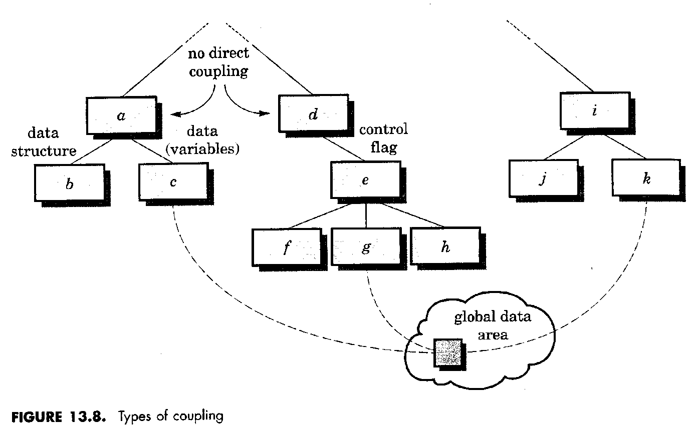
Coupling
4. Common Coupling
Takes place when a number of modules access a data item in a global data area.
Modules c, g and k exhibit common coupling

Slide 33
Coupling
5. Content coupling (Least desirable)
Two modules are said to be content coupled if one module branches into another module or modifies data within another.
Eg:
int func1(int a)
{ printf(“func1”);
a+=2;
goto F2A;
return a;
}
void func2(void)
{ printf(“func2”);
F2A : printf(“At F2A”)
}

Slide 34
Eg: Part of a program that handles lookup for a customer.
When customer not found, component adds customer by directly modifying the contents of the data structure containing customer data.

Slide 35
Design Concepts
Refinement
Process of elaboration.
Start with the statement of function defined at the abstract level, decompose the statement of function in a stepwise fashion until programming language statements are reached.

Slide 36
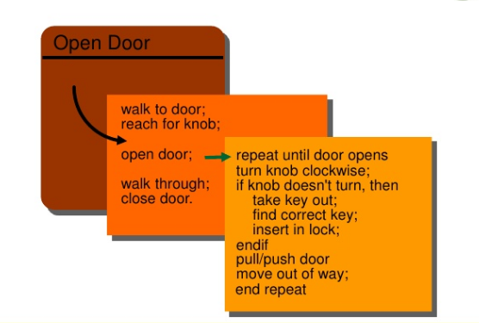
Stepwise refinement

Slide 37
Design Concepts
Refactoring
Reorganization technique that simplifies the design
(or code) of a component without changing its
function or behavior
“Refactoring is the process of changing a software system in such a way that it does not alter the external behavior of the code [design] yet improves its internal structure.”

Slide 38
When software is refactored, the existing design is examined for redundancy, unused design elements, inefficient or unnecessary algorithms, poorly constructed or inappropriate data structures, or any other design failure that can be corrected to yield a better design.
For example, a first design iteration might yield a component that exhibits low cohesion (i.e., it performs three functions that have only limited relationship to one another). After careful consideration, you may decide that the component should be refactored into three separate components, each exhibiting high cohesion

Slide 39
Design Concepts
Design Classes
As the design model evolves, you will define a set of design classes that refine the analysis classes by providing design detail that will enable the classes to be implemented and implement a software infrastructure that supports the business solution.

Slide 40
User interface classes
define all abstractions that are necessary for human-computer interaction (HCI). In many cases, HCI occurs within the context of a metaphor (e.g., a checkbook, an order form) and the design classes for the interface may be visual representations of the elements of the metaphor.

Slide 41
Business domain classes
are often refinements of the analysis classes defined earlier. The classes identify the attributes and services (methods) that are required to implement some element of the business domain.
Process classes
implement lower-level business abstractions required to fully manage the business domain classes.

Slide 42
Persistent classes
represent data stores (e.g., a database) that will persist beyond the execution of the software.
System classes
implement software management and control functions that enable the system to operate and communicate within its computing environment and with the outside world

Slide 43
Four characteristics of well-formed design class:
Complete and sufficient
Primitiveness (easier to understand, reusable)
High cohesion
Low coupling

Slide 44
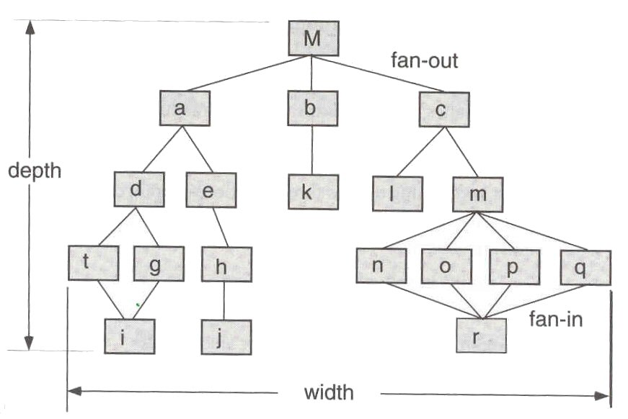
Design Concepts
Control Hierarchy

Slide 45
Design Concepts(Control Hierarchy)
Also called program structure
Represent the organization of program components.
Does not represent procedural aspects of software such as decisions, repetitions etc.
Depth –No. of levels of control (distance between the top and bottom modules in program control structure)
Width- Span of control.
Fan-out -no. of modules that are directly controlled by another module
Fan-in - how many modules directly control a given
module

Slide 46
Design Concepts(Control Hierarchy)
Super ordinate -module that control another module
Subordinate - module controlled by another

Slide 47
Design Concepts
Data structure
is a representation of the logical relationship among individual elements of data.
Scalar item –
A single element of information that may be
addressed by an identifier .
Scalar item organized as a list- array
Data structure that organizes non-contiguous scalar items-linked list

Slide 48
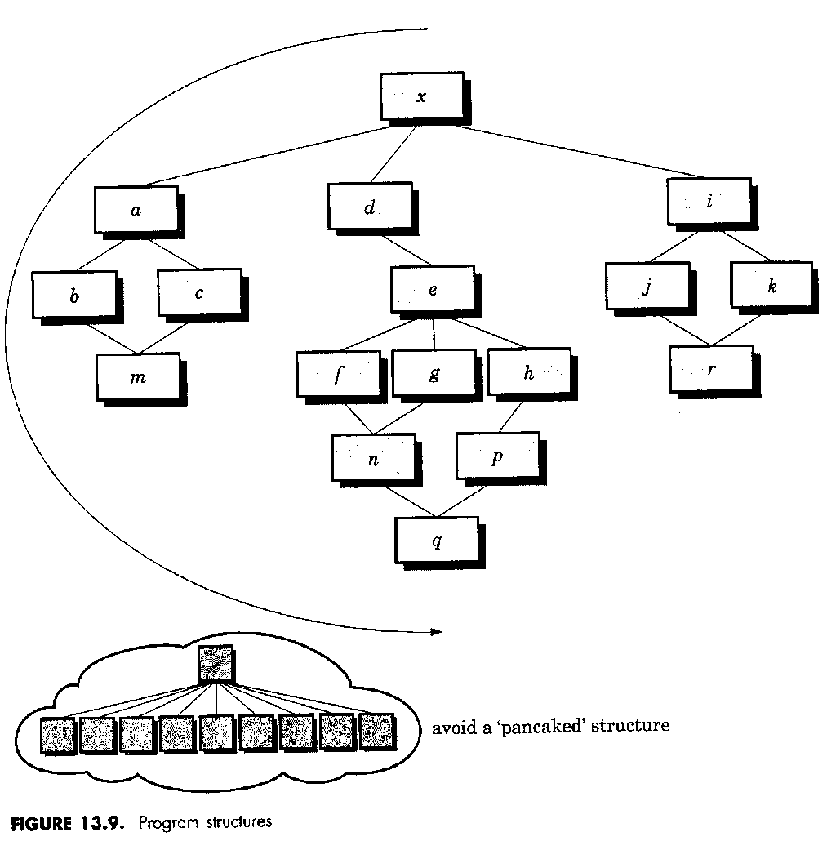
Design heuristics for effective modularity
Evaluate 1st iteration to reduce coupling & improve cohesion
Minimize structures with high fan-out
Keep scope of effect of a module within scope of control of that module

Slide 49
Design heuristics for effective modularity
Evaluate interfaces to reduce complexity
Define modules with predictable function
Strive for controlled entry -- no jumps into the middle

Slide 50
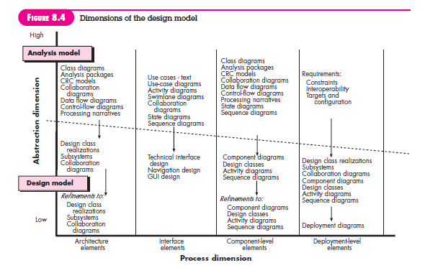
Design Model

Slide 51
Data Design Elements
Like other software engineering activities, data design (sometimes referred to as data architecting) creates a model of data and/or information that is represented at a high level of abstraction (the customer/user’s view of data).
This data model is then refined into progressively more implementation-specific representations that can be processed by the computer-based system.

Slide 52
Architectural Design Elements
The architectural design for software is the equivalent to the floor plan of a house
The architectural design element is usually depicted as a set of interconnected subsystems, often derived from analysis packages within the requirements model.
Each subsystem may have it’s own architecture (e.g., a graphical user interface might be structured according to a preexisting architectural style for user interfaces).

Slide 53
Interface Design Elements
The interface design elements for software depict information flows into and out of the system and how it is communicated among the components defined as part of the architecture.
There are three important elements of interface design: (1) the user interface (UI); (2) external interfaces to other systems, devices, networks, or other producers or consumers of information; and (3) internal interfaces between various design components.
These interface design elements allow the software to communicate externally and enable internal communication and collaboration among the components that populate the software architecture.

Slide 54
Component level design elements
The component-level design for software fully describes the internal detail of each software component.
To accomplish this, the component-level design defines data structures for all local data objects and algorithmic detail for all processing that occurs within a component and an interface that allows access to all component operations (behaviors).

Slide 55
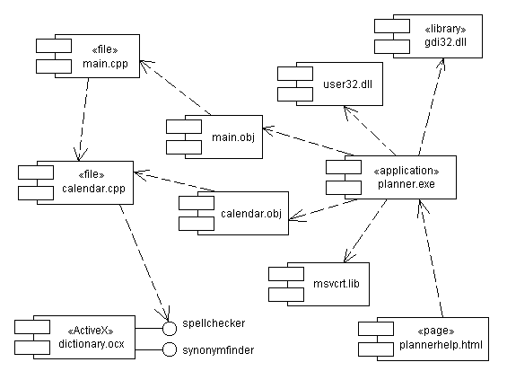

Slide 56
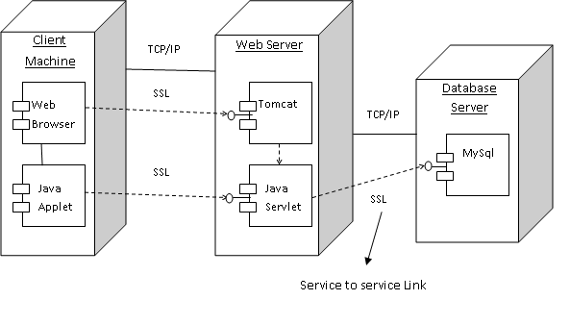
Deployment level design elements
Deployment-level design elements indicate how software functionality and subsystems will be allocated within the physical computing environment that will support the software.

